Slide 1
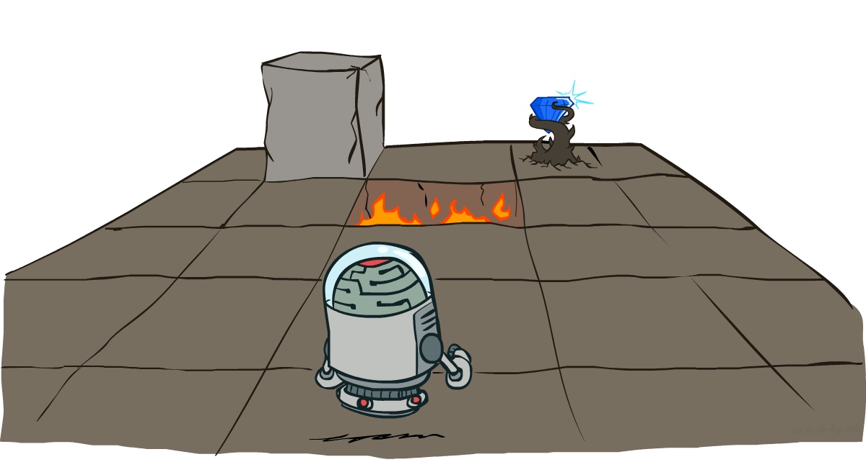
CS7050 Artificial Intelligence
Markov Decision Processes – Part I: Non-Deterministic Search
[With thanks to Dan Klein and Pieter Abbeel from UC Berkeley. http://ai.berkeley.edu.]
Notes:
Please retain proper attribution, including the reference to ai.berkeley.edu. Thanks!

Slide 2





Example: Grid World
A maze-like problem: looking for the gold in the grid with walls
The agent changes the location using Move - like before
No senses to prevent from falling in a pit or hitting the walls - the pits complicate life while the walls prevent movements
Unlike before, actions do not always go as planned
80% of the time, the action Move takes the agent North; 10% of the time, West; 10%, East (if there is no wall there)
If there is a wall in the direction the agent would have been taken, the agent remains in the place
The agent receives rewards each time it performs a move
Each reward can be positive (bonus) or negative (penalty)
Small rewards are received at each step, big reward - at the end
Final reward comes as a total (can be good or bad)
Goal: maximize the sum of all rewards received at every step
Notes:
[cut demo of moving around in grid world program]

Slide 3
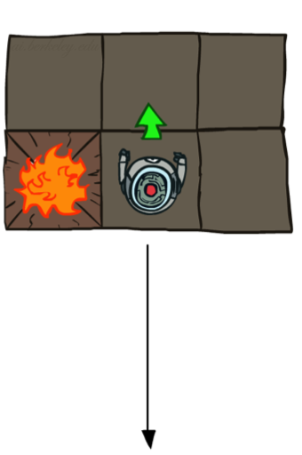
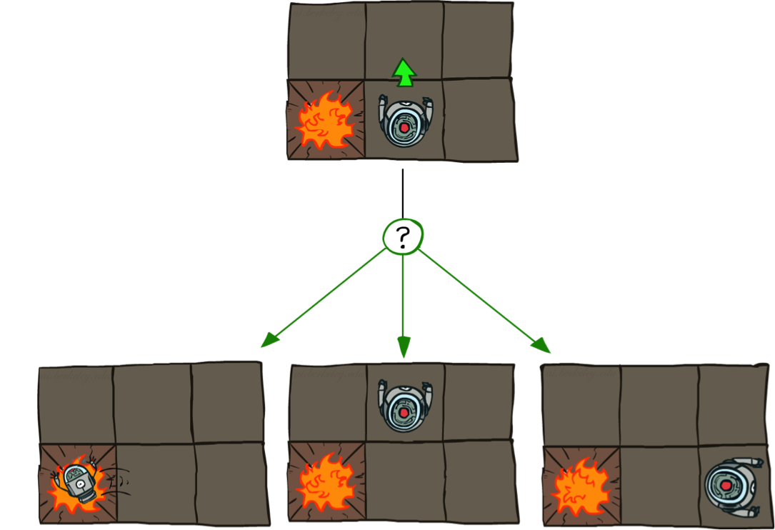

Grid World Actions
Deterministic Grid World
Non-tererministic (Stochastic) Grid World
Which direction?
North!

Slide 4
Markov Decision Processes
An Markov Decision Process (MDP) is defined by:
A set of states s ∈ S
A set of actions a ∈ A
A transition function T(s, a, s’) : S x A → S
Probability that an action a from state s potentially leads to a state s’, i.e., P(s’| s, a)
Also called transition, or model of the dynamics
A reward function R(s, a, s’, N) : S x A x S → N
Quantitative measure of the actual change
Can be constant, linear, weighted sum, etc.
A start state s₀
(Possibly also) a terminal state s_{n}
MDPs are non-deterministic search problems
One way to solve them is with heuristic search, considering as heuristic the reward
We’ll have a new tool soon (optimization)
Notes:
In search problems: did not talk about actions, but about successor functions --- now the information inside the successor function is unpacked into actions, transitions and reward
Write out S, A, example entry in T, entry in R
Reward function different from the book : R(s,a,s’)
In book simpler for equations, but not useful for the projects.
Need to modify expectimax a tiny little bit to account for rewards along the way, but that’s something you should be able to do, and so you can already solve MDP’s (not in most efficient way)

Slide 5

Video of Demo Gridworld Manual Intro

Slide 6

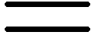
What is Markov about MDPs?
The adverb “Markov” or “Markovian” generally means that given the present state, the future and the past are independent
For MDP, “Markov” means action outcomes depend only on the current state, not on the full history of movements before it
so each transition from a state s_{t} to state s_{t+1} depends only on the
state s_{t}, not on the previous states s_{t-1, …} s₀
This is very much like search, where the successor function could only depend on the current state (not on the operations which led to it)
Andrey Markov
(1856-1922)
Russian Mathematician
Notes:
Like search: successor function only depended on current state
Can make this happen by stuffing more into the state;
Very similar to search problems: when solving a maze with food pellets, we stored which food pellets were eaten

Slide 7

Policies
In deterministic single-agent search problems, we wanted a plan for acting in the form of a sequence of actions from start (initial state) to end (goal state)
π =<a₀,a₁,…a_{t-1}>
For MDPs, we want an optimal policy instead
π*: S → A
A policy π is a function giving an action for each state
An optimal policy π* is one that maximizes the expected utility (the reward)
The deterministic search algorithms didn’t compute entire policies
They computed the action for a single state only
Optimal policy when R(s, a, s’) = -0.03 for all non-terminals s
Notes:
Dan has a DEMO for this.

Slide 8
Optimal policies for different rewards
R(s) = -0.01
R(s) = -0.03
R(s) = -0.4
R(s) = -2.0
Notes:
R(s) = the “living reward”

Slide 9
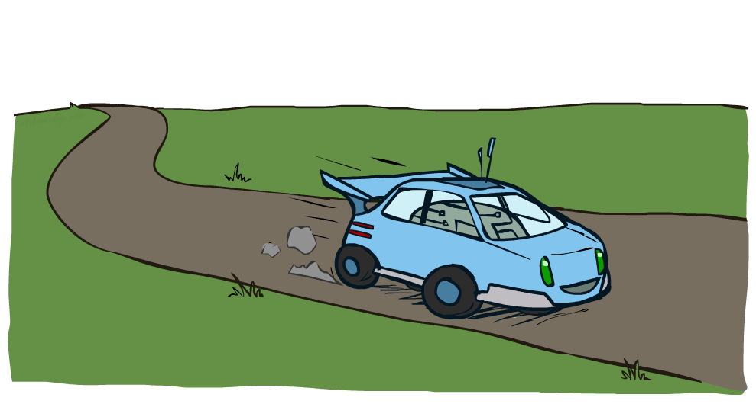
Example: Racing Cars

Slide 10
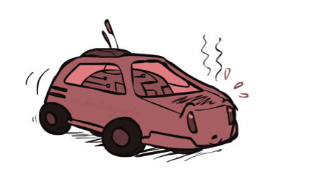

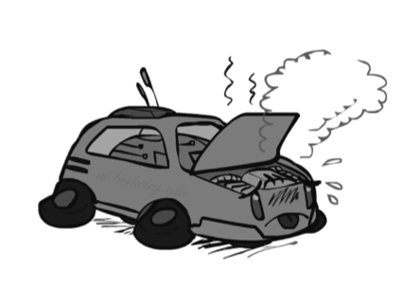
Example: Racing Cars
MDP: A driverless car must travel as far as possible, as quick as possible
Three states: Cool, Warm, Overheated (initial state is Cool, final state can be any of the three)
Two actions: Slow, Fast (with equal probability)
Rewards (for saving the engine, moving and traveling longer):
cooling down (from wormer to cooler) gets +0.5
heating up (from cooler to warmer) gets -0.5
going fast (keeping fast) gets double reward +2.0
going slow (keeping slow) gets +1.0
Final reward:
Overheating is penalized (-10)
Slow
-0.5
+1
+0.5
Fast
Slow
-10
+1
+0.5
-0.5
Warm
Fast
+2
Slow
Fast
Cool
Overheated
+0.5
+1
-0.5
+2

Slide 11


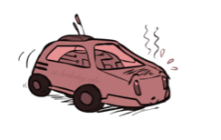
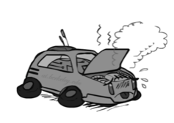
Racing Cars Search Tree
Slow
Fast
Fast
Fast
Slow
Slow
Fast
Slow
Fast
Slow
Fast
Slow
Fast
Fast
Slow
Fast
Fast
Slow
Slow
Fast

Slide 12


MDP Search Trees
Each MDP state projects an heuristic-like search tree
with additional information associated with the nodes and branches
s
s is a state
a
(s, a) is a q-state
s, a
(s,a) is a transient q-state
(s,a,s’) is a transition, associated with it are
T(s,a,s’) = P(s’|s,a) is its probability to happen
R(s,a,s’) is its utility value contribution to the goal
s,a,s’
s’
Notes:
In MDP chance node represents uncertainty about what might happen based on (s,a) [as opposed to being a random adversary]
Q-state (s,a) is when you were in a state and took an action

Slide 13
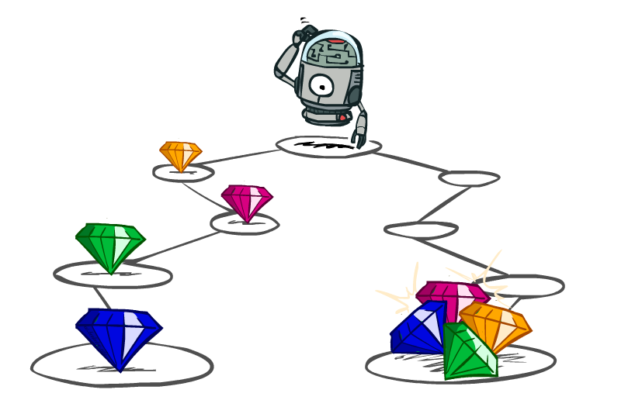
Utilities along the paths
The final rewards is cumulative, a sum of utilities along the path
It’s often useful to maximize the final reward in terms of some meaningful criteria, like
Shortest path
Fastest reach
Lowest cost
Biggest chance to avoid pits
Smallest risk to hit walls, etc.

Slide 14




Preferencial rewarding
It’s also reasonable to prefer changing rewards, i.e., higher reward earlier rather than later
values of the rewards decrease constantly (linear function)
values of the rewards decay exponentially (polynomial function)
Highest Worth Now
Worth Next Step
Worth In Two Steps

Slide 15

Discounting
Why discount?
More intuitive - earlier rewards do have higher utility value than later rewards
Also helps our algorithms converge to a fixpoint (i.e., converging to a point of reward 100%, or neutralizing to value 0)
How to discount?
Each time we descend a reward level, we multiply it by the discount once
Example: discounting by 50% three states
U([1,2,3]) = 1*1 + 0.5*2 + 0.25*3 = 2.75
U([3,2,1]) = 1*3 + 0.5*2 + 0.25*1 = 4.25
U([1,2,3]) < U([3,2,1])
Notes:
Rewards in the future (deeper in the tree) matter less
Interesting: running expectimax, if having to truncate the search, then not losing much; e.g., less then \gamma^d / (1-\gamma)

Slide 16
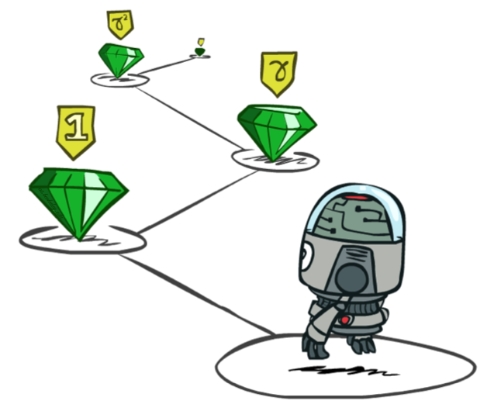
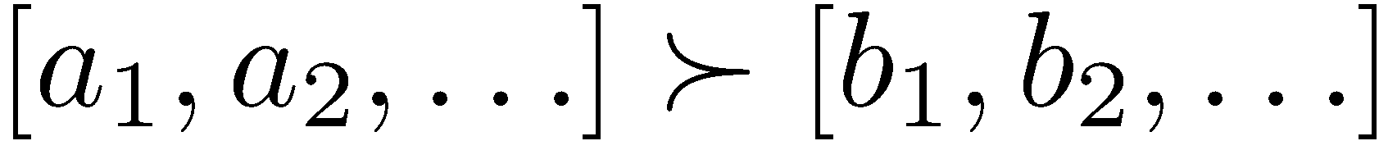
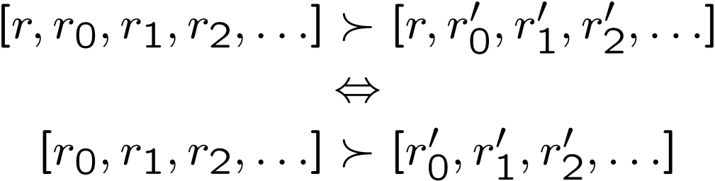
Stationary Preferences
Theorem: if we assume stationary preferences:
where a ≻b means “a is preferrable than b”, then there are
only two ways to define utilities
Additive utility:
Discounted utility:

Slide 17

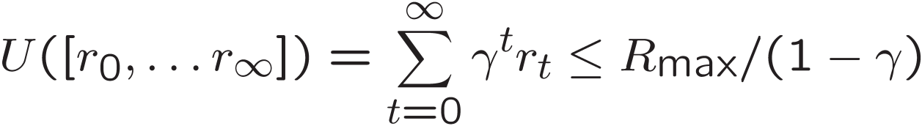
Infinite Utilities?!
Problem: What if the game lasts forever? Do we get infinite rewards?
Solutions:
Finite horizon: (similar to depth-limited search)
Terminate episodes after a fixed T steps (e.g. until life)
Gives nonstationary policies (π depends on steps left)
Discounting: use 0 < γ < 1
(Smaller γ means smaller “horizon” – i.e., focus on shorter path)
Absorbing state: guarantee that for every policy, a terminal state will eventually be reached (like in racing “overheating” state is bad because it causes crash, while “cool” state is good because the car remains intact)

Slide 18
Recap: Defining MDPs
Markov decision processes:
Set of states S
Start state s₀
Set of actions A
Transitions P(s’|s,a) (or T(s,a,s’))
Rewards R(s,a,s’) (and discount γ)
MDP solution in terms of:
Policy = Choice of action for each state
Utility = sum of (possibly discounted) rewards
s
a
s, a
s,a,s’
s’

Slide 19
Solving MDPs

Slide 20
Calculating Quantities
The value (utility) of a state s:
V*(s) = expected utility starting in s and acting optimally
The value (utility) of a q-state (s,a):
Q*(s,a) = expected utility starting out having taken action a from state s and continung acting optimally
The optimal policy:
π*(s) = optimal action from state s
s
s is a state
a
(s, a) is a q-state
s, a
s,a,s’
(s,a,s’) is a transition
s’
[Demo – gridworld values (L8D4)]
Notes:
[Note: this demo doesn’t show anything in action, just pops up V and Q values.]

Slide 21
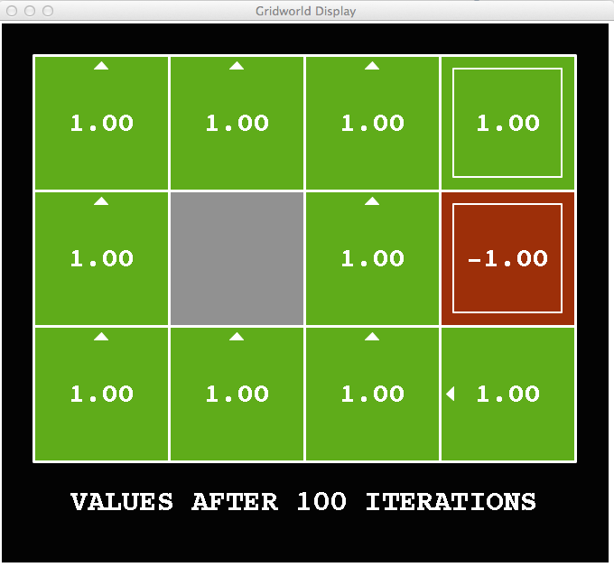
Snapshot of Demo – Gridworld V Values
Noise = 0
Discount = 1
Living reward = 0
Notes:
This demo doesn’t show anything in action, it just shows the V and Q values.

Slide 22
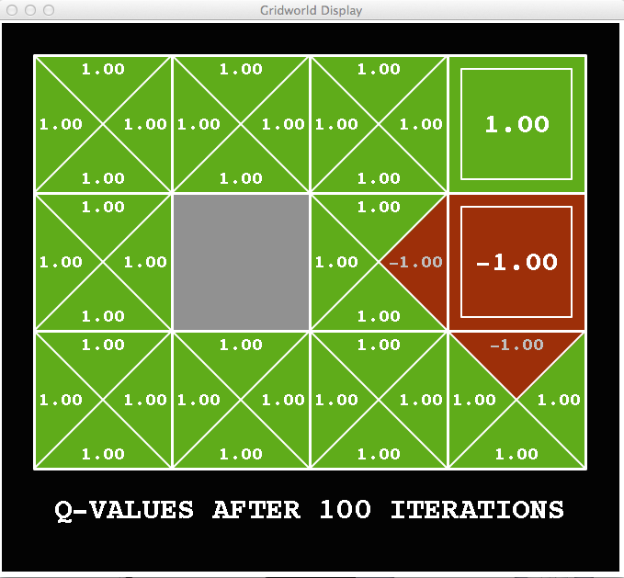
Snapshot of Demo – Gridworld Q Values
Noise = 0
Discount = 1
Living reward = 0
Notes:
This demo doesn’t show anything in action, it just shows the V and Q values.

Slide 23

Snapshot of Demo – Gridworld V Values
Noise = 0.2
Discount = 1
Living reward = 0
Notes:
This demo doesn’t show anything in action, it just shows the V and Q values.

Slide 24
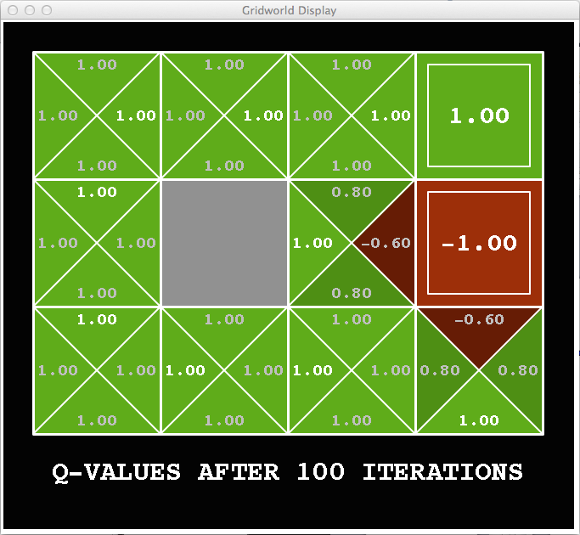
Snapshot of Demo – Gridworld Q Values
Noise = 0.2
Discount = 1
Living reward = 0
Notes:
This demo doesn’t show anything in action, it just shows the V and Q values.

Slide 25
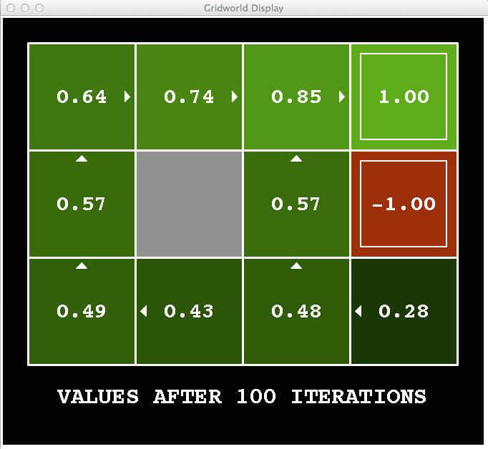
Snapshot of Demo – Gridworld V Values
Noise = 0.2
Discount = 0.9
Living reward = 0
Notes:
This demo doesn’t show anything in action, it just shows the V and Q values.

Slide 26
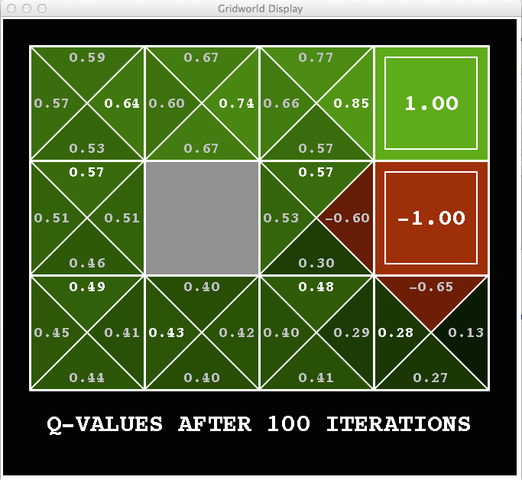
Snapshot of Demo – Gridworld Q Values
Noise = 0.2
Discount = 0.9
Living reward = 0
Notes:
This demo doesn’t show anything in action, it just shows the V and Q values.

Slide 27
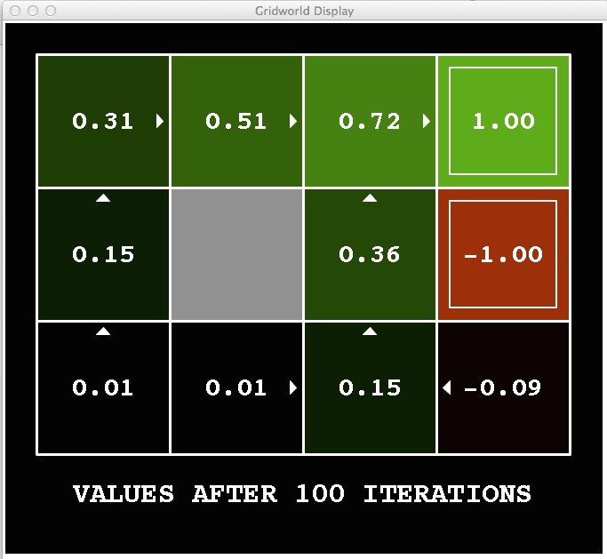
Snapshot of Demo – Gridworld V Values
Noise = 0.2
Discount = 0.9
Living reward = -0.1
Notes:
This demo doesn’t show anything in action, it just shows the V and Q values.

Slide 28
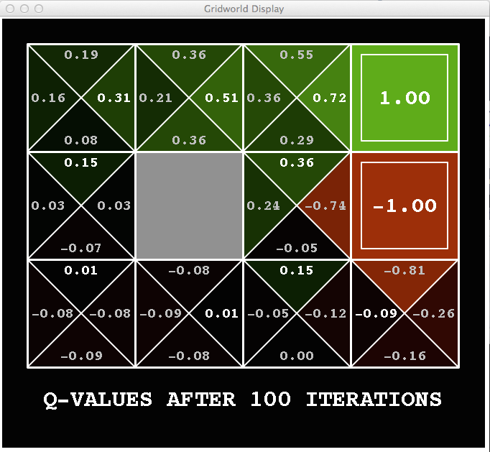
Snapshot of Demo – Gridworld Q Values
Noise = 0.2
Discount = 0.9
Living reward = -0.1
Notes:
This demo doesn’t show anything in action, it just shows the V and Q values.

Slide 29


Values of States
Fundamental operation: compute the heuristic value of a state
Expected utility under optimal action
Average sum of (discounted) rewards
This is exactly the heuristic we can use!
Recursive definition of the value:
s
a
s, a
s,a,s’
s’

Slide 30
Example: Racing Search Tree

Slide 31


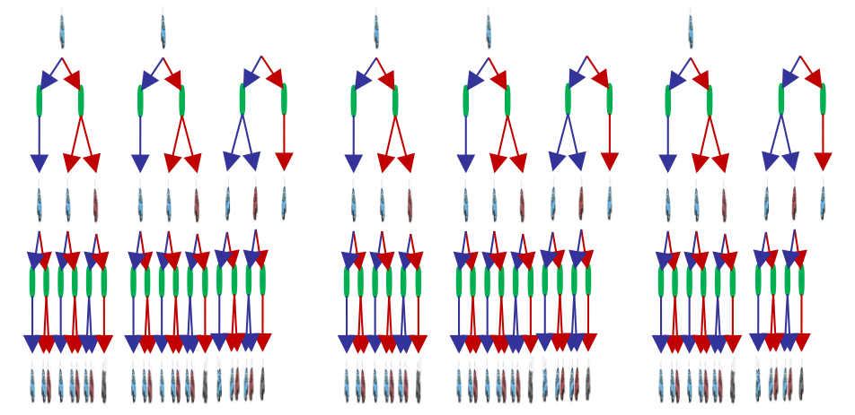
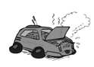
Racing Search Tree
We’re doing way too much work with heuristic search!
Hint: States are repeated
Idea: Only compute needed quantities once
Problem: Tree goes on forever
Idea: Do a depth-limited computation, but with increasing depths until change is small
Note: deep parts of the tree eventually don’t matter if γ < 1

Slide 32


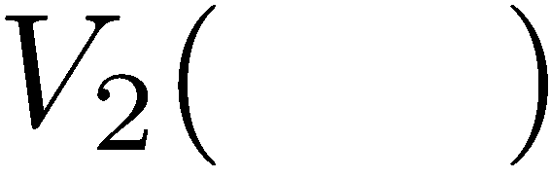

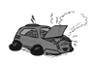
Time-Limited Values
Key idea: time-limited values
Define V_{k}(s) to be the optimal value of s if the game ends in k more time steps
Equivalently, it’s what a depth-k heuristic search would give from s
[Demo – time-limited values (L8D6)]
Notes:
This demo generates the time-limited values for gridworld as snapshotted onto the next slides.

Slide 33
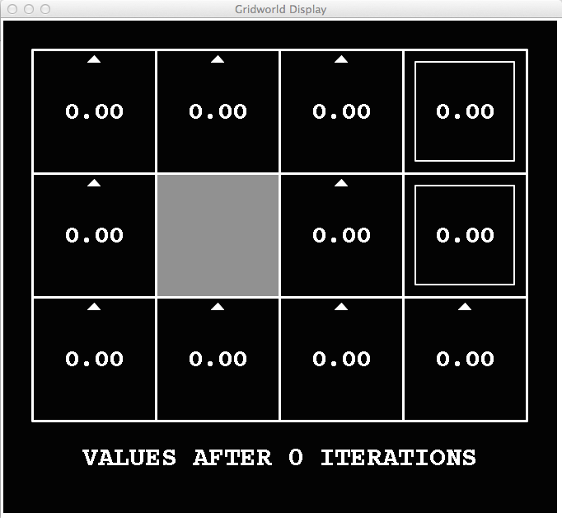
k=0
Noise = 0.2
Discount = 0.9
Living reward = 0
Notes:
Assuming zero living reward

Slide 34
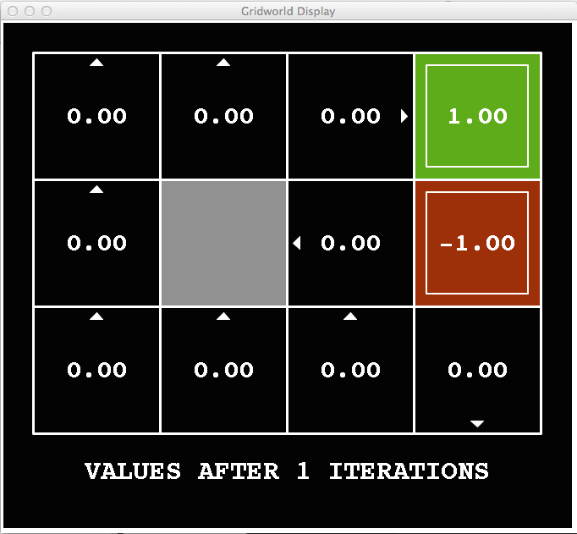
k=1
Noise = 0.2
Discount = 0.9
Living reward = 0
Notes:
Assuming zero living reward

Slide 35
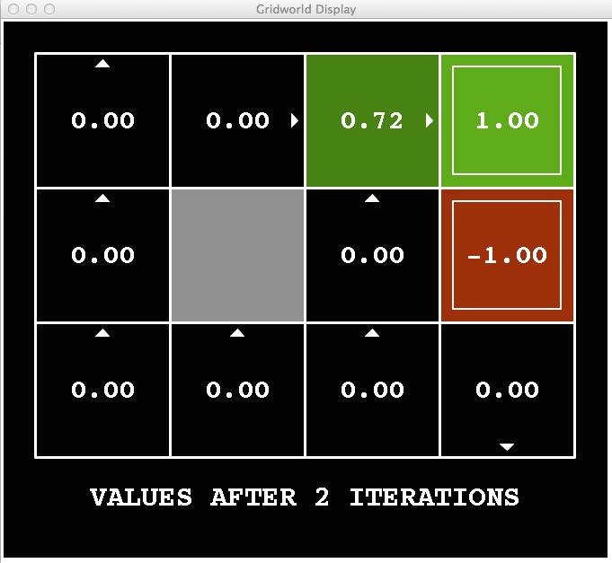
k=2
Noise = 0.2
Discount = 0.9
Living reward = 0
Notes:
Assuming zero living reward

Slide 36
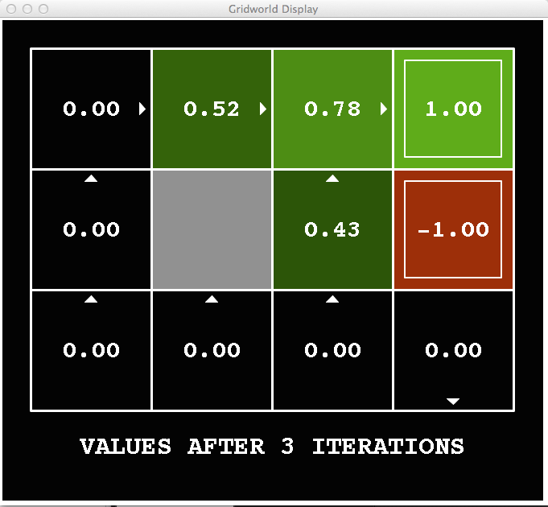
k=3
Noise = 0.2
Discount = 0.9
Living reward = 0
Notes:
Assuming zero living reward

Slide 37
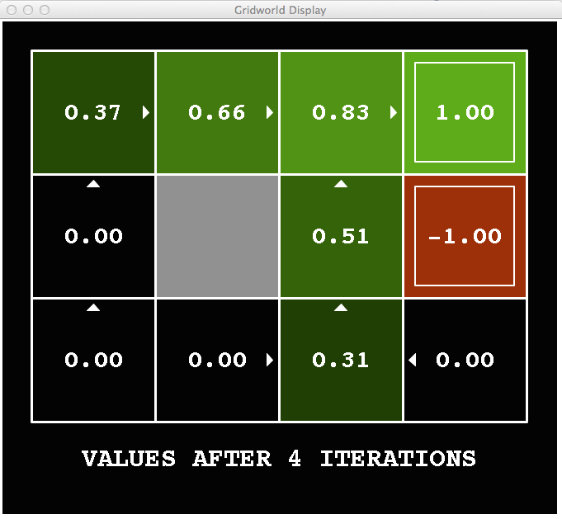
k=4
Noise = 0.2
Discount = 0.9
Living reward = 0
Notes:
Assuming zero living reward

Slide 38
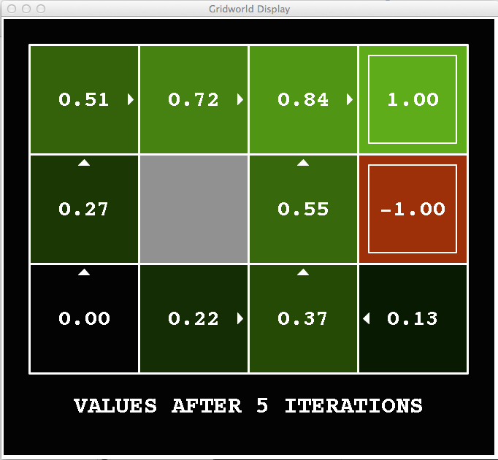
k=5
Noise = 0.2
Discount = 0.9
Living reward = 0
Notes:
Assuming zero living reward

Slide 39
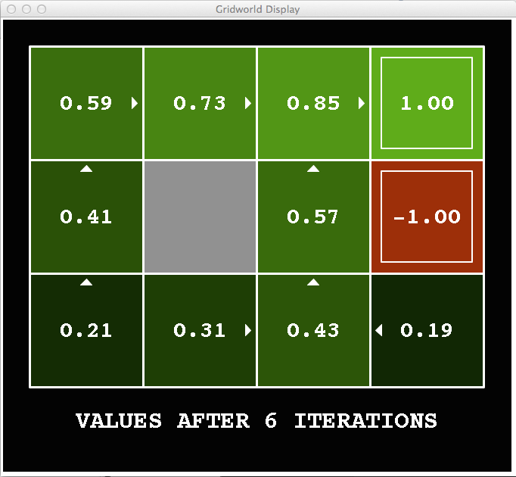
k=6
Noise = 0.2
Discount = 0.9
Living reward = 0
Notes:
Assuming zero living reward

Slide 40
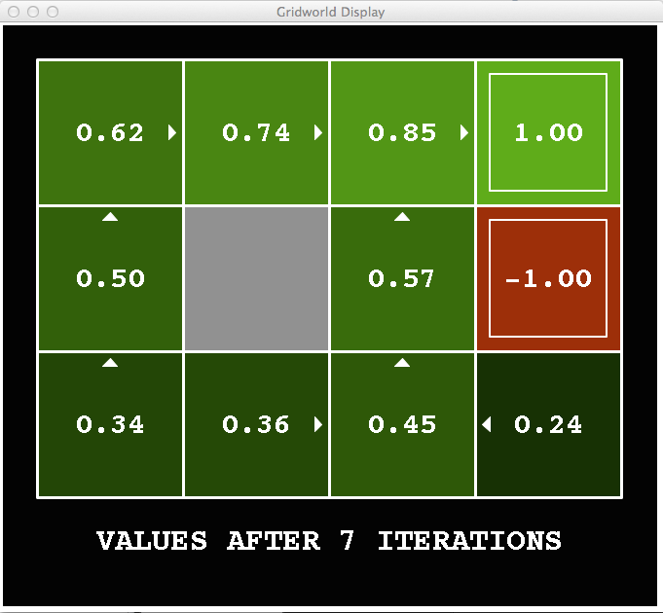
k=7
Noise = 0.2
Discount = 0.9
Living reward = 0
Notes:
Assuming zero living reward

Slide 41
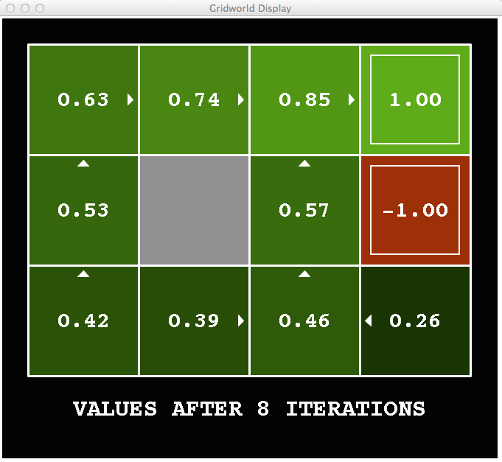
k=8
Noise = 0.2
Discount = 0.9
Living reward = 0
Notes:
Assuming zero living reward

Slide 42
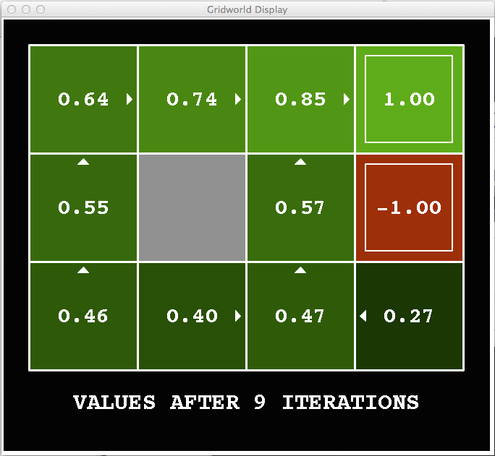
k=9
Noise = 0.2
Discount = 0.9
Living reward = 0
Notes:
Assuming zero living reward

Slide 43

k=10
Noise = 0.2
Discount = 0.9
Living reward = 0
Notes:
Assuming zero living reward

Slide 44

k=11
Noise = 0.2
Discount = 0.9
Living reward = 0
Notes:
Assuming zero living reward

Slide 45

k=12
Noise = 0.2
Discount = 0.9
Living reward = 0
Notes:
Assuming zero living reward

Slide 46

k=100
Noise = 0.2
Discount = 0.9
Living reward = 0
Notes:
Assuming zero living reward

Slide 47
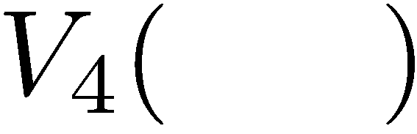

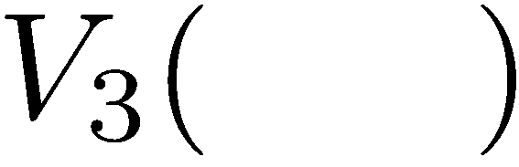
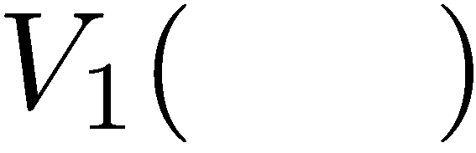
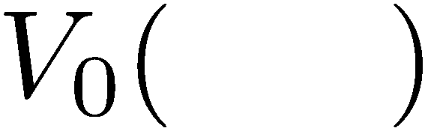
Computing Time-Limited Values

